Slide 1
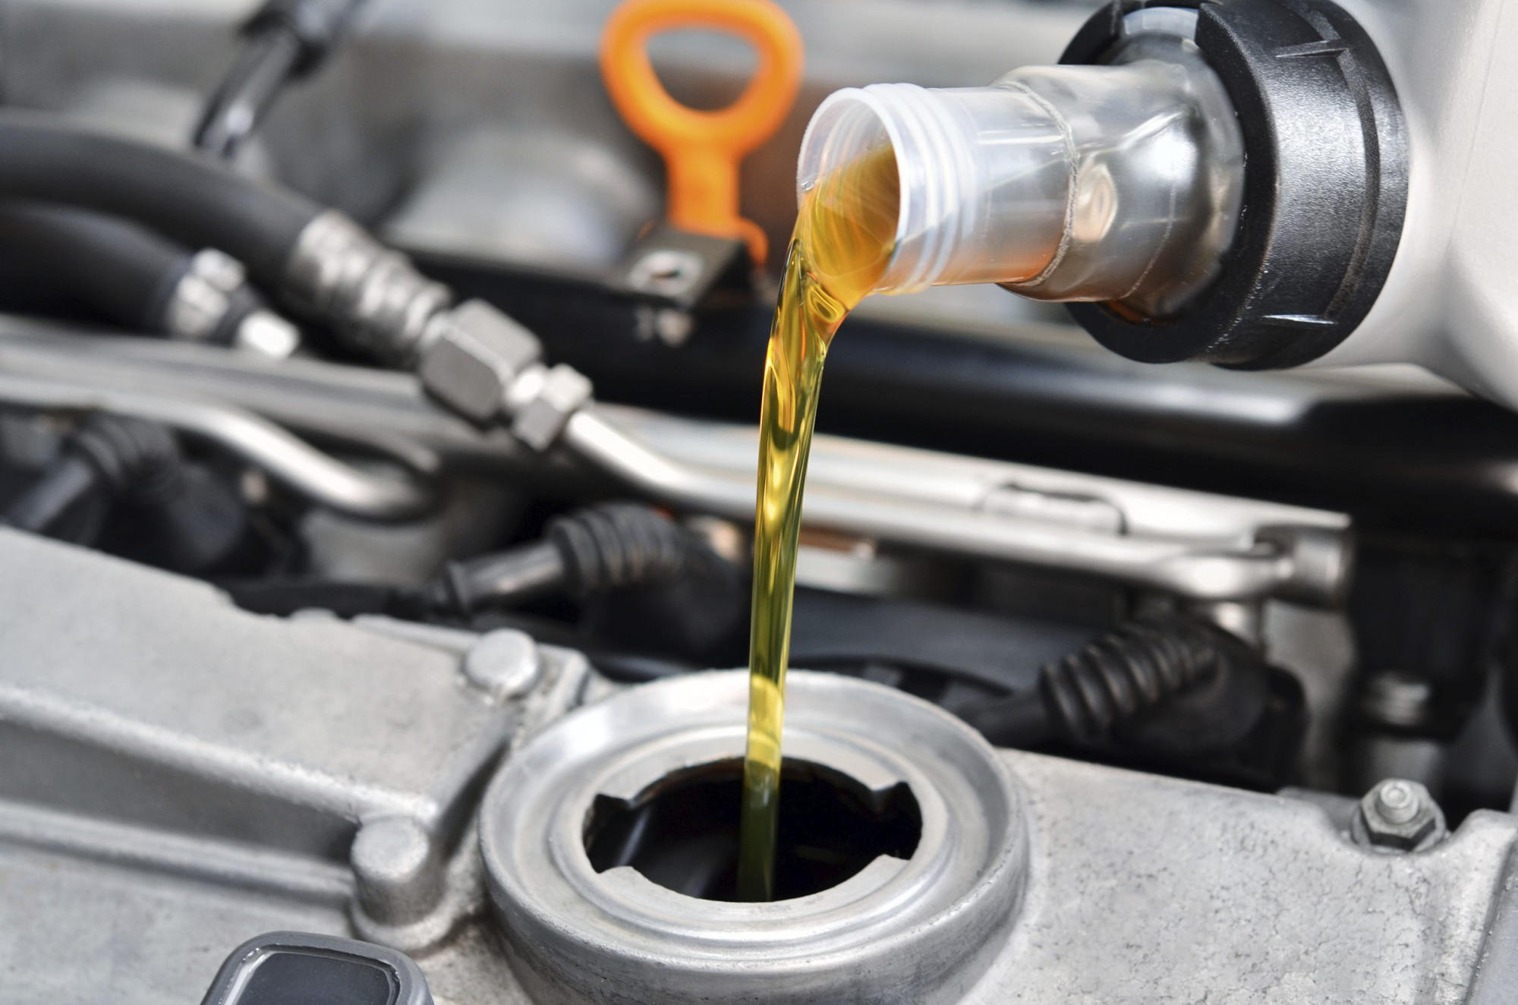
Talking Cars
(and trucks)
Samuel C. Hollifield
CodeMash
January 2019
Free PowerPoint Templates
Free PowerPoint Templates
Notes:
Good Morning!
Talking to cars – we are going to build an interface to talk to a car.
We will learn about a few different technologies and by the end will be ready to programmatically interact with a vehicular network.
DON’T GET FRUSTRATED. It rarely works the first time. I will be around all week and have open spaces on Thursday.

Slide 2
Who am I?
Perpetual Student, National Lab Collaborator
Automotive enthusiast
Python-lover
Breaker of hardware
From a tiny town (<750 people)
Security Researcher
Free PowerPoint Templates
Free PowerPoint Templates
Notes:
Automotive enthusiast (I own too many vehicles).
First language was Java so I love Python.
Only person from my small town to become a researcher.

Slide 3
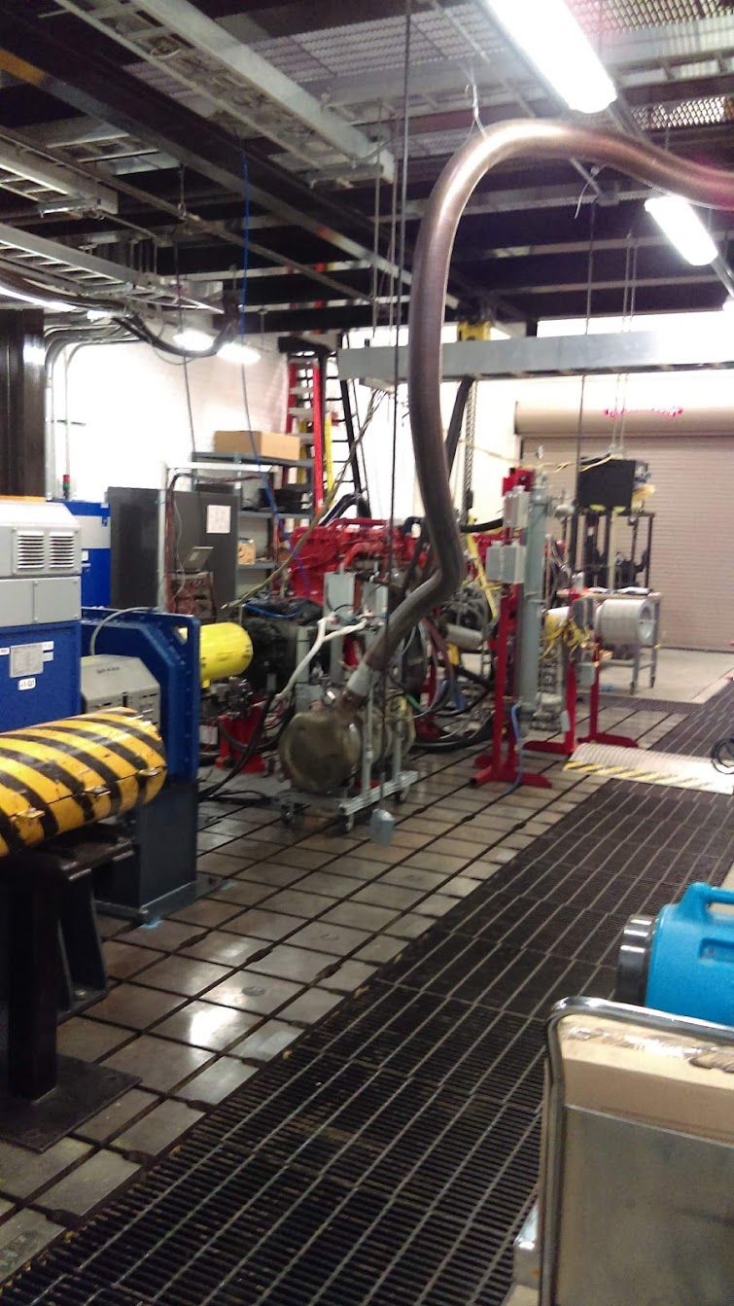
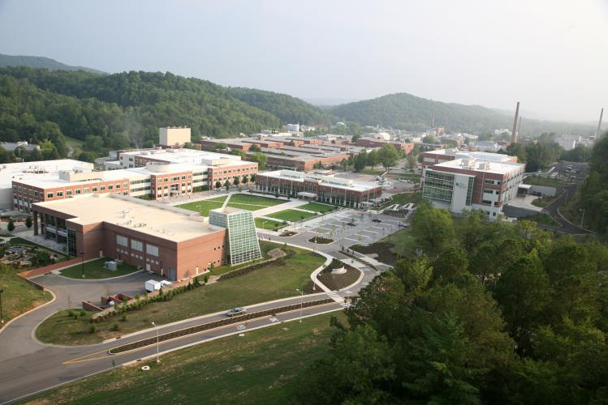
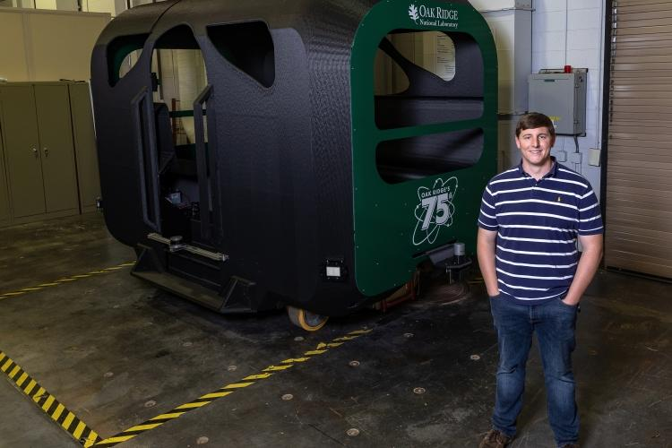
Vehicle Security at a National Lab?
Free PowerPoint Templates
Notes:
Why does the Government want to look at vehicle security?
Everything rides on the backbone of transportation. If that is compromised, bad news.
On top of security, we do fuels efficiency research and have even 3D printed our own self-driving bus.

Slide 4
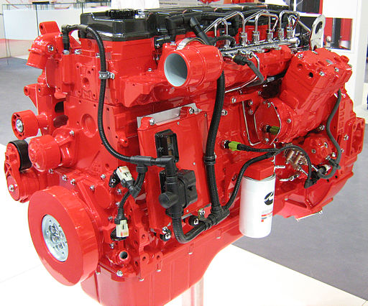
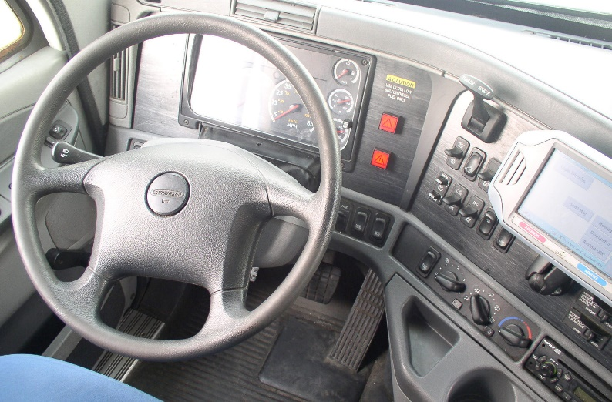
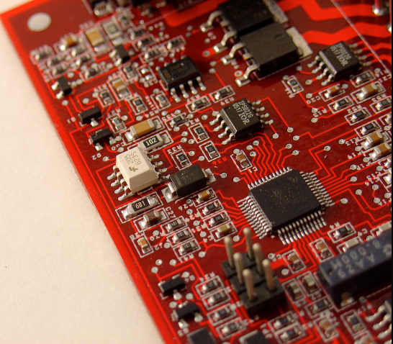
Free PowerPoint Templates
Notes:
What is a 2019 vehicle and why does it need security?
Due to many reasons (emissions, technology, price) components are networked instead of serially connected.
Many vehicles even elect for telematics control which offers remote diagnostics and info.

Slide 5
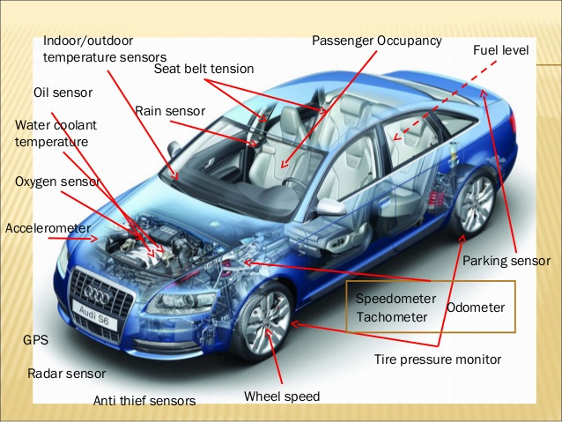
There can be hundreds of sensors, dozens of electronic control units
Free PowerPoint Templates
Notes:
This network can get expansive, with dozens of sensors or hundreds of Electronic Control Units (ECUs)
The sensors typically connect to an ECU and will not transmit raw data through the network.
Sensors include oil, tpms, mass airflow, wheel speed.

Slide 6
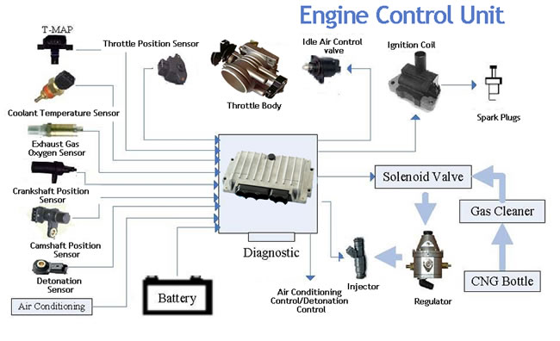
What is an Electronic Control Unit? (ECU)
www.apriliaforum.com
Free PowerPoint Templates
Notes:
ECUs take sensor inputs, make some sort of logic, then pass it through the network.
There are many different types of ECUs across different vehicles.
Usually they serve a specific purpose, but at the end of the day an ECU is a computer.

Slide 7
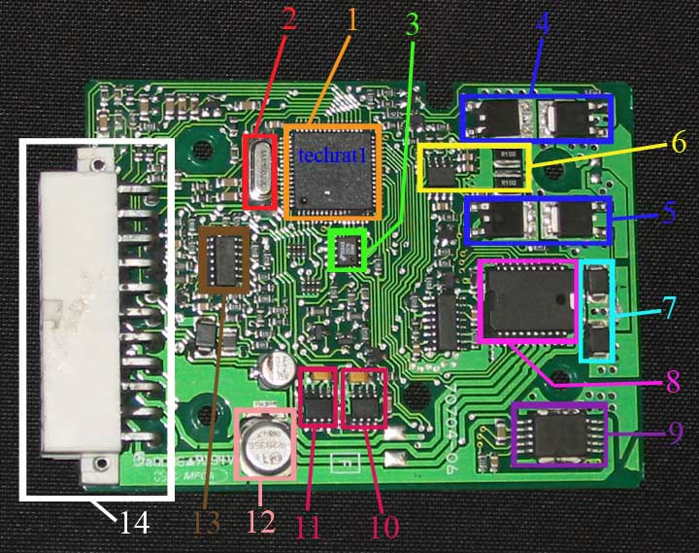
Inside an Electronic Control Unit? (ECU)
www.apriliaforum.com
Free PowerPoint Templates
Notes:
Pieces of an ECU: (Biggest are usually more interesting)
1 CPU/Microcontroller This one is a Motorola MC68HC908
3. EEPROM 25C16 (Serial Periphreal Interface Electrically Eraseable Programmable Read-Only Memory)
These could be interesting to look at if you’re looking to change lookup tables or something.

Slide 8
Types of ECUS
Body Control Module
Anti-lock Braking System Control Module
Emission Control Module
Transmission Control Module
Seatbelt Restraint Control Unit
Powertrain Control Module
Safety Systems Control Module
Infotainment Control Module
<insert noun> Control Module
Free PowerPoint Templates
Notes:
There are many types of ECUs
Popular ones include Body Control Module, Engine Control Module
Can be random ones such as ‘primary seatbelt restraint control module’. <Insert Noun> Control Module.

Slide 9
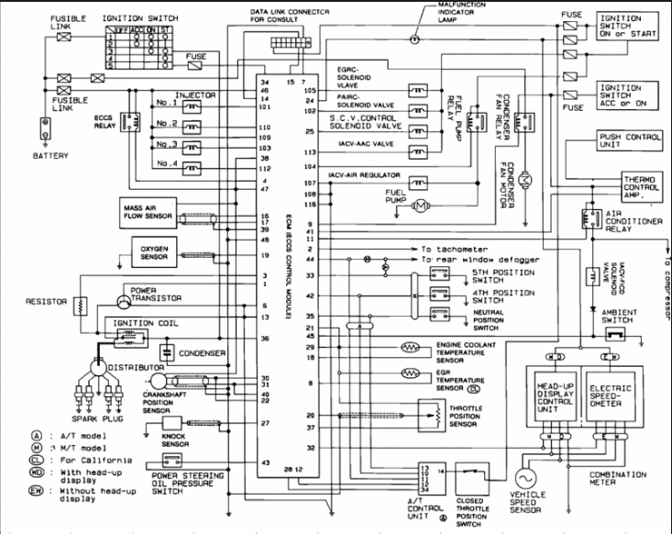


Best way to know what your car has?
Free PowerPoint Templates
Notes:
How do you know which control modules are in your vehicle?
Easiest way is to check the ‘back of the book’
Harder is to dig into the car and start googling.

Slide 10
Like computers, ECUs use networks to communicate.
Most common: CAN (on all vehicles after 2008)
Somewhat common: LIN, SWCAN, GMLAN
On older vehicles: PWM, VPW, proprietary interfaces
Infotainment might have: Bluetooth, 4G LTE, WiFi
Free PowerPoint Templates
Notes:
Similar to computers, ECUs need a network to communicate.
The most common network is CAN. It’s also the topic of this talk.
Les common include SWCAN, GMLAN which is proprietary, and older networks.
Infotainments may include additional features such as Bluetooth, wifi, etc.

Slide 11
Where is the network?
Free PowerPoint Templates
Free PowerPoint Templates
Notes:
The most common place to access the network as a user is the OBD port under the hood.
This is where mechanics will do diagnostics, manufacturers may reprogram ECUs.
Truthfully, we can connect anywhere there are CAN wires however.

Slide 12
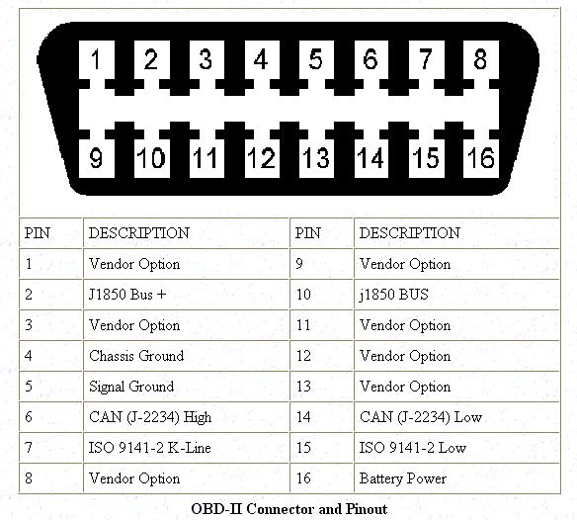
Where can we talk?
Free PowerPoint Templates
Free PowerPoint Templates
Notes:
The OBD is a 16-pin plug but CAN is only on 2 of them.
Although 6 and 14 are mandated as CAN lines, OEMs may include additional networks.
We aren’t able to just plug a serial connector or OBD-to-USB into our computer however, we need specialized parts.

Slide 13
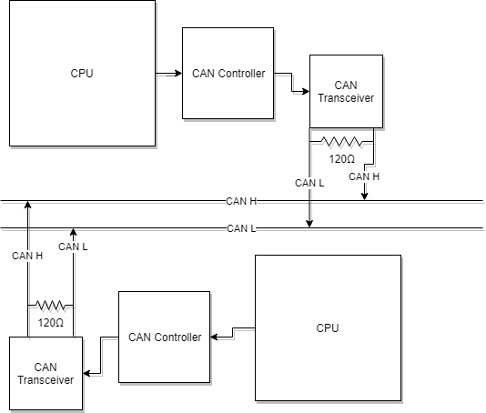
Free PowerPoint Templates
Free PowerPoint Templates
Notes:
In order to communicate via CAN, we need a CAN Transceiver and a CAN Controller.
The CAN Transceiver interprets voltage into bits.
The CAN Controller turns bits into CAN packets.

Slide 14
Physical CAN Connections
Free PowerPoint Templates
Free PowerPoint Templates
Notes:
The Transceiver connects to a CAN-H and CAN-L line (High and Low)
These wires twist and are stretched across the vehicle. Iterate that anywhere these wires exist one can connect to CAN.
Why twisted? Avoid electromagnetic interference. Also note the resistance: This is to stop reflections.

Slide 15
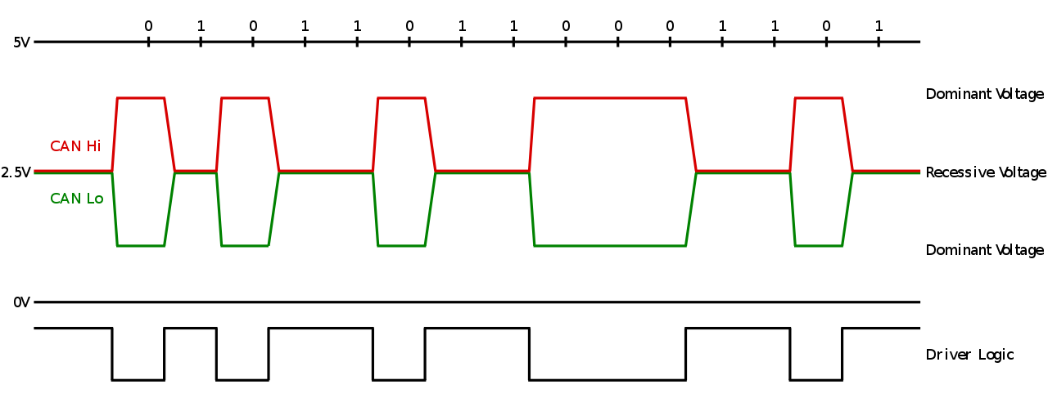
Free PowerPoint Templates
Free PowerPoint Templates
Notes:
CAN works as a differential signal.
At idle, 2.5v, a 1 is transmitted. When CAN-H and CAN-L are pulled apart a 0 is transmitted.
0 is a dominant bit. This makes sense: at bus idle we send a 1, which gets overwritten if the voltage is altered.

Slide 16
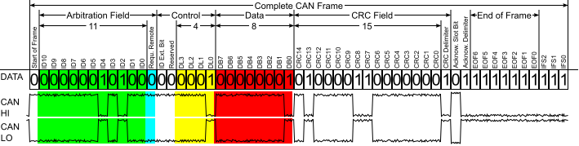
Free PowerPoint Templates
Free PowerPoint Templates
Notes:
This is a complete CAN Packet (but we call it a frame). Take note of the red and green shaded areas.
Green is Arbitration Field. This is a unique identifier for the message which also serves to determine priority.
Red is the data field. This is the actual payload/message – very small, only 8 bits. There can be 8 data fields in a CAN message.

Slide 17
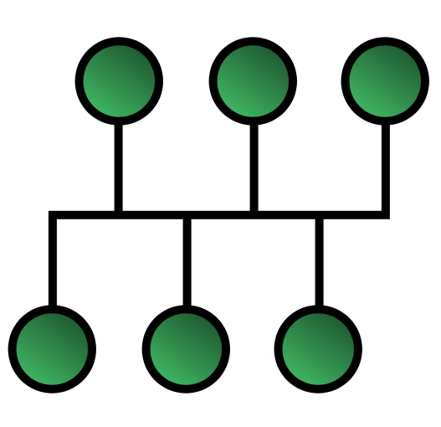
CAN Bus Features
No Node Authentication
Broadcast Bus Network
Easily Disrupted
Free PowerPoint Templates
Free PowerPoint Templates
Notes:
When sending messages, all nodes receive them.
There is no authentication to ensure the message sender is who they say they are.
It’s easily disrupted. If you spam 0s it will completely overload the arbitration function.
#####BATHROOM BREAK######

Slide 18
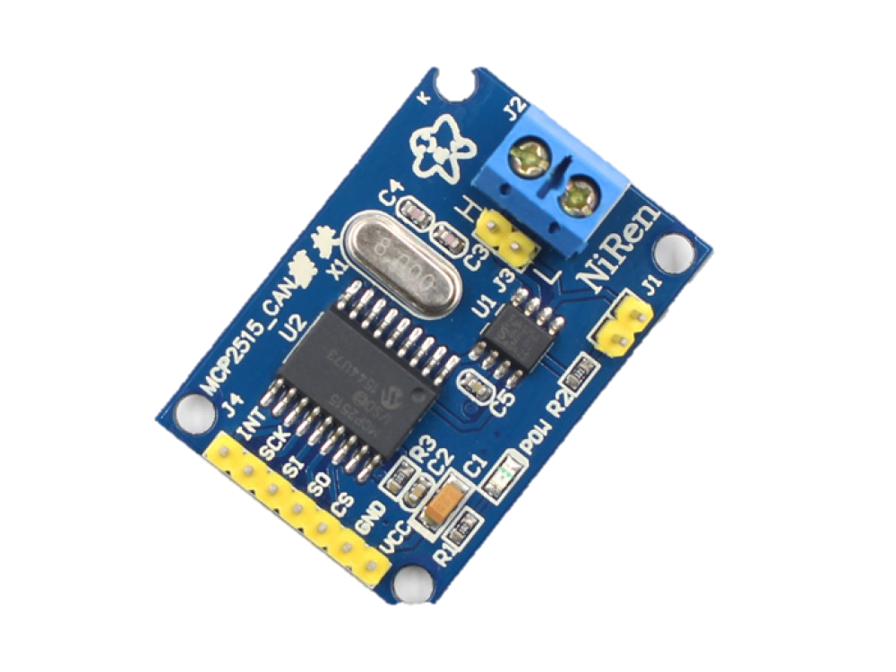
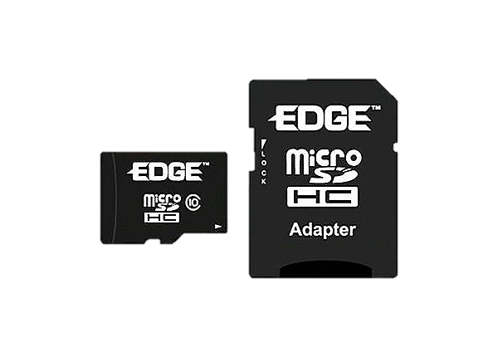
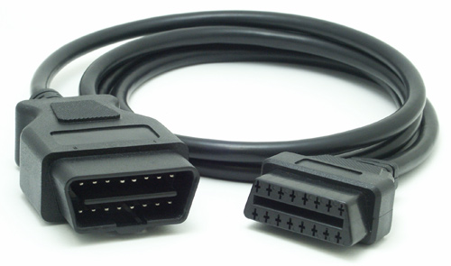
Why Raspberry Pi?
Cheap!
Python compatible
Ubiquitous
Huge support community
Good amount of compatible sensors
Free PowerPoint Templates
Notes:
Best way to learn is hands-on so we will build a Raspberry Pi ECU!
Why Raspberry Pi? It’s Cheap. Works with Python. Great support community.
Good amount of compatible sensors but we may need to do some tricks with voltage.

Slide 19
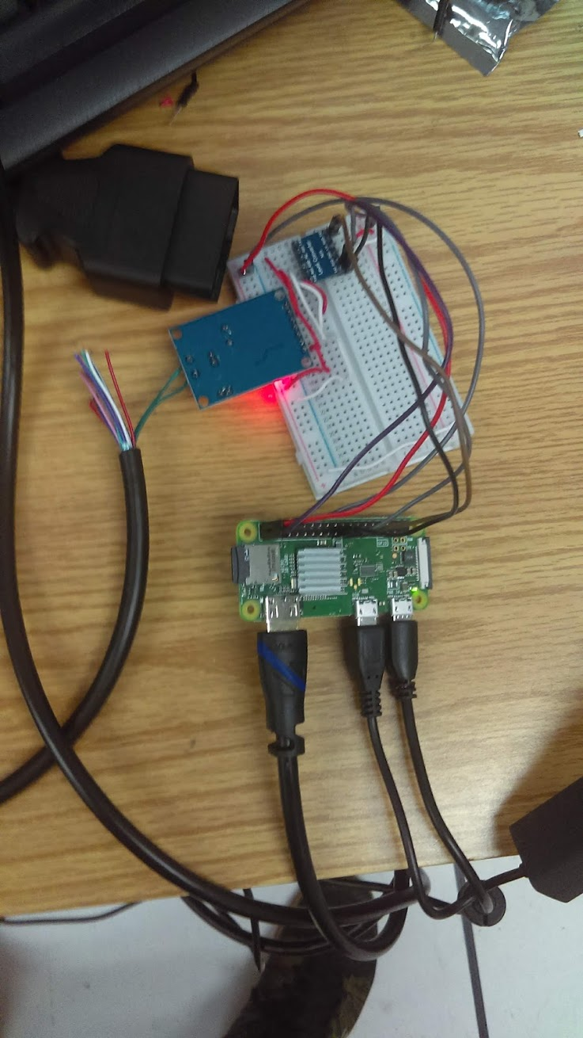
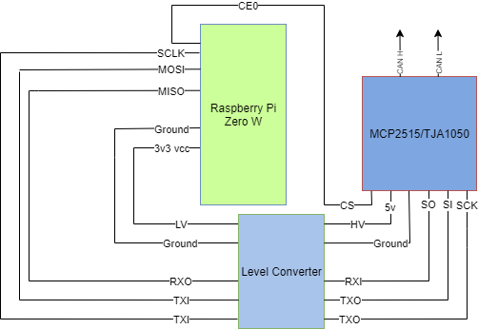
Finished Product First!
Free PowerPoint Templates
Notes:
Finished product first!
Raspberry Pi Zero W using SPI to communicate with a CAN daughter board via SPI.
The CAN daughter board is an MCP2515/TJA1050. Alphabet soup. Get used to it!

Slide 20
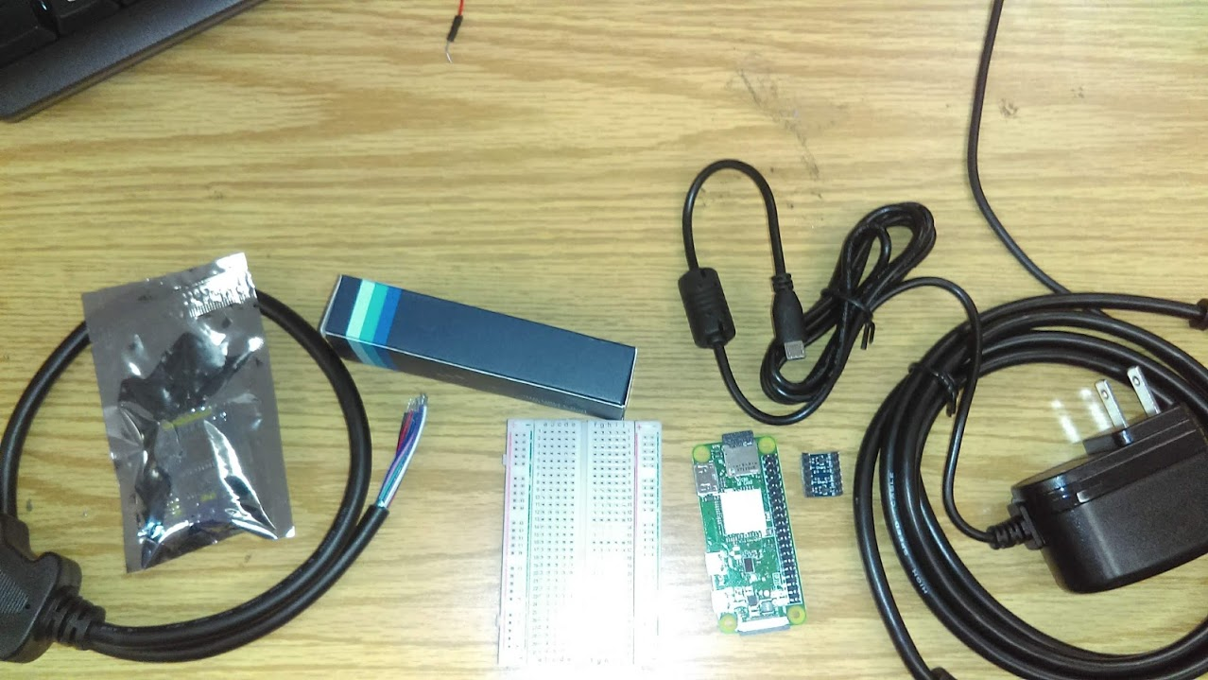
Check your bags!
(1) Raspberry Pi Zero W
(1) Level Converter
(1) Mini-USB Hub
(1) Mini HDMI-to-HDMI
(1) AC-to-DC Adapter
(1) CAN Daughter Board(MCP2515/TJA1050)
(1) OBD-II Automotive Cable
(1) Breadboard
Assorted wires, jumpers, cables.
Free PowerPoint Templates
Notes:
Let’s double check that we have all the parts.
Get a show of hands: Has anyone used a Raspberry Pi?
Has anyone used a breadboard?
Has anyone used CAN?

Slide 21
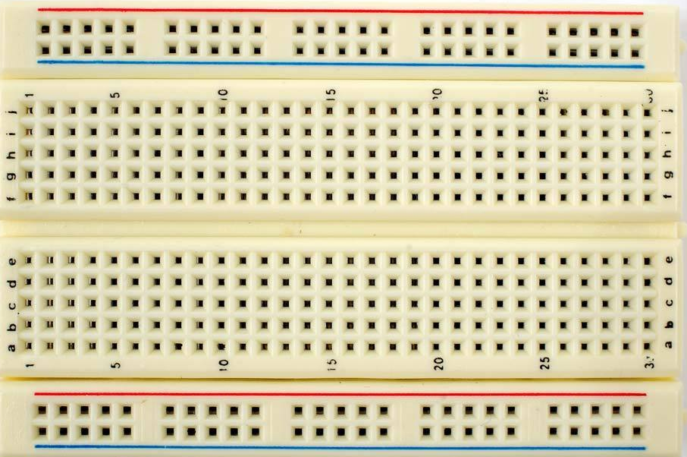
How do breadboards work?
Free PowerPoint Templates
Free PowerPoint Templates
Notes:
Look at the breadboard! These are very useful for quickly prototyping without a bunch of soldering.
Columns on outside travel downward for power rails.
Inside grid travels horizontally from a – e, then f – j.
The connection is terminated at the middle, which lets us place our level converter directly in the center. Creating a High-Voltage and Low-Voltage side.

Slide 22
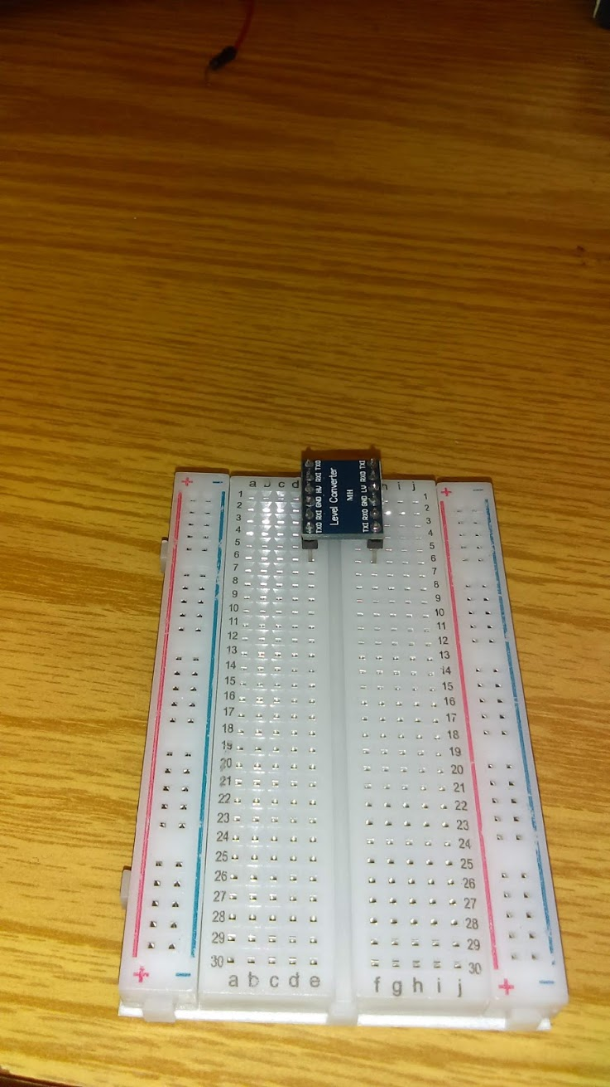
STEP 1!
Insert the Level Converter, ensuring HV is on the ‘a-e’ side.
Free PowerPoint Templates
Free PowerPoint Templates
Notes:
We will divide our breadboard into a ‘high voltage’ and ‘low voltage’ side.
A – E will be HV, F – J will be LV
Make sure to put it on E1-E6 & G1-G6
The reason we need to do this is because the CAN transmits a 0 at 5V, but our Raspberry Pi will burn up if we send 5v to it. The level converter steps it down to 3v3.

Slide 23
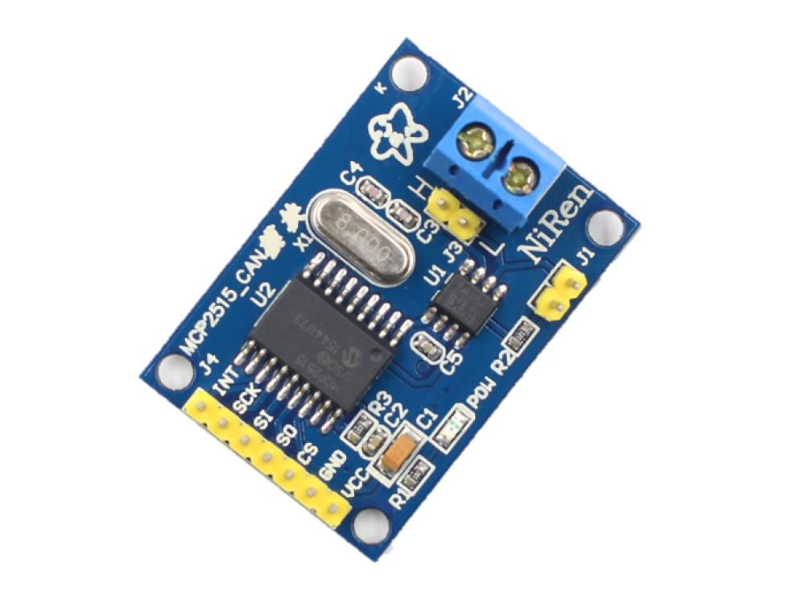
STEP 2.a
Analyze the CAN Daughter Board (MCP2515/TJA1050)
MCP2515
TJA1050
Free PowerPoint Templates
Free PowerPoint Templates
Notes:
TJA 1050: Transceiver that interprets voltage into bits
MCP2515: Controller which turns bits into CAN frames.

Slide 24
STEP 2.a
Analyze the CAN Daughter Board (MCP2515/TJA1050)
Serial Peripheral
Interface (SPI)
(to Level Converter)
CAN (to car)
Free PowerPoint Templates
Free PowerPoint Templates
Notes:
CAN jumpers will go to the OBD/car
SPI will go to the Raspberry Pi

Slide 25
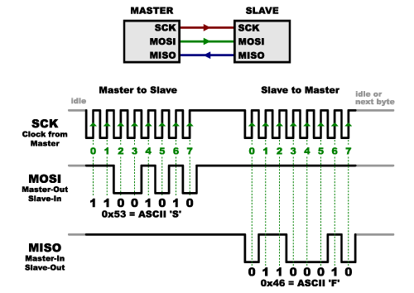
Tangent: What’s SPI?
Sparkfun.com is a great resource for SPI/electronics in general!
Free PowerPoint Templates
Free PowerPoint Templates
Notes:
We’re using this to connect our MCP2515 CAN Interface to our Raspberry Pi
SCK is the clock. This tells the controller where to sample
MOSI is signal FROM the Master (in our case, Raspberry Pi) to the Slave
MISO is signal FROM the Slave (in our case, the CAN board) to the Master

Slide 26
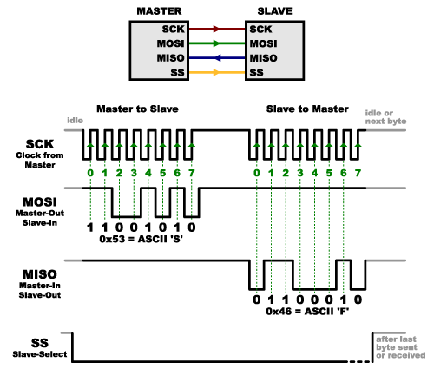
Tangent: How does SPI work with Raspberry Pi?
Sparkfun.com is a great resource for SPI/electronics in general!
Free PowerPoint Templates
Free PowerPoint Templates
Notes:
SPI is a Master / Slave system, so we use a SS (slave-select) line to give the device permission to talk.
The master keeps track of the clock (SCK) which tells each device when to sample the lines.
Then, communication occurs synchronously on each line between MOSI and MISO.

Slide 27
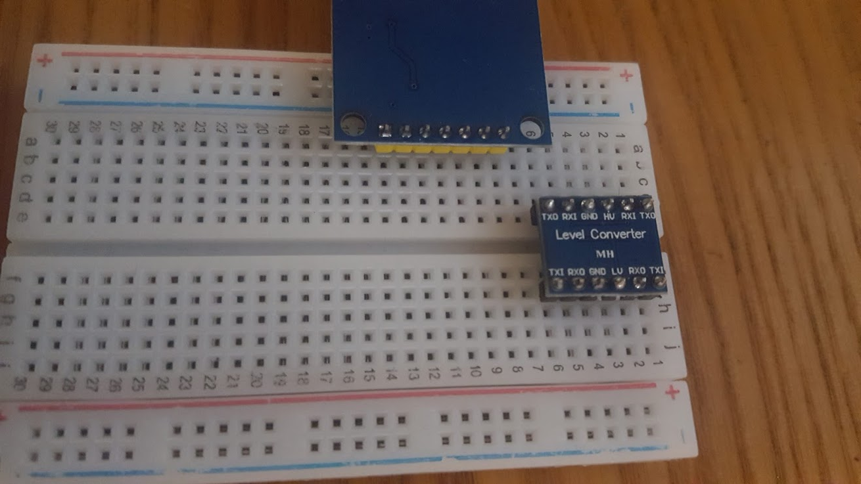
STEP 2.c!
Insert the CAN Daughter Board into (A,8)—(A,14)
Free PowerPoint Templates
Free PowerPoint Templates
Notes:
Install the CAN board to the Breadboard.
I went (A,8) -- (A,14)
Make sure not to plug into the Pos or Neg

Slide 28
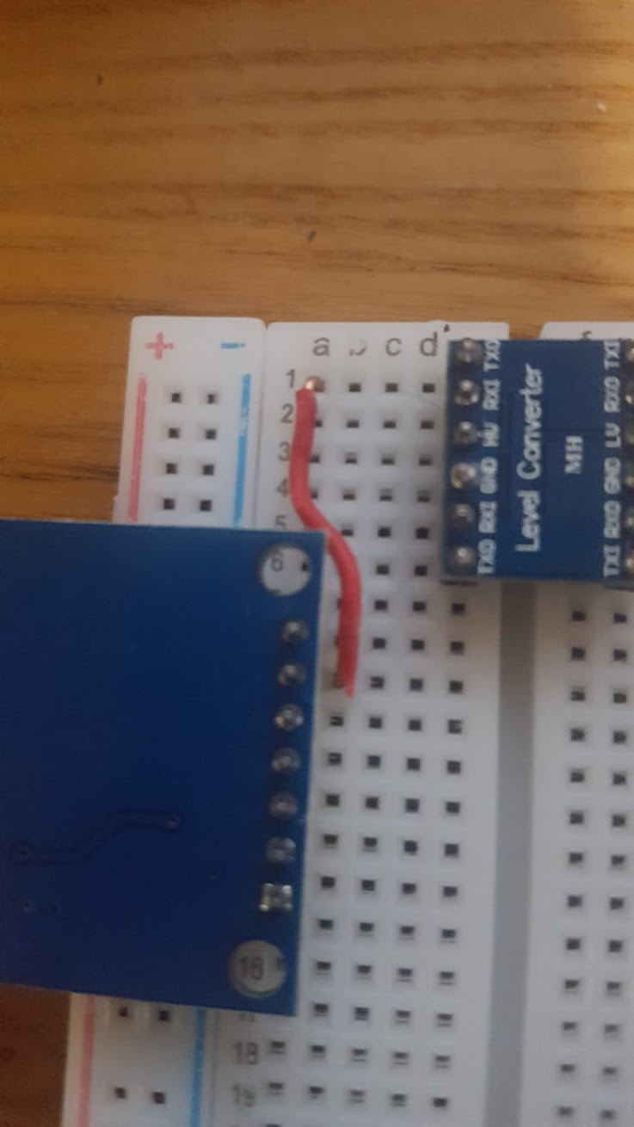
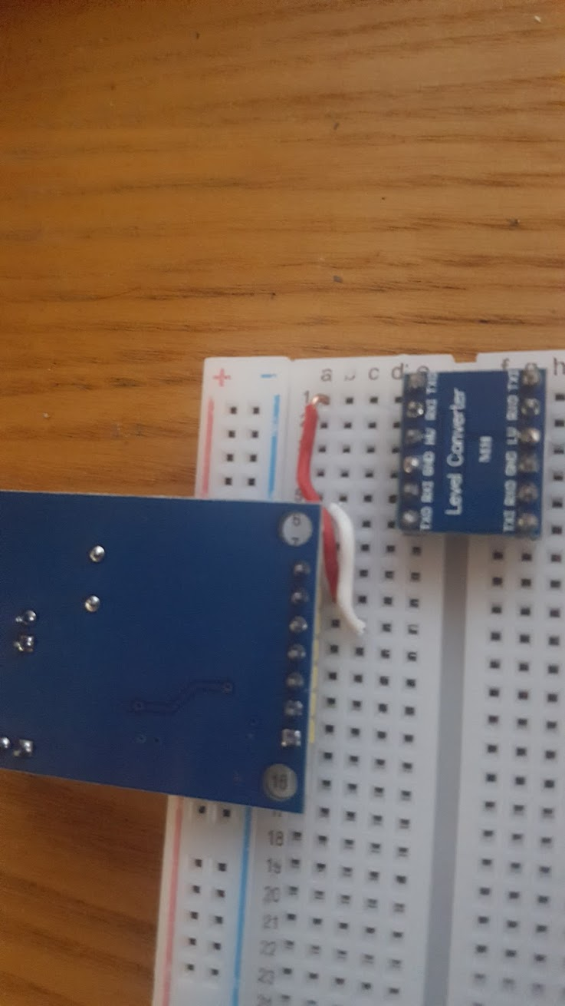
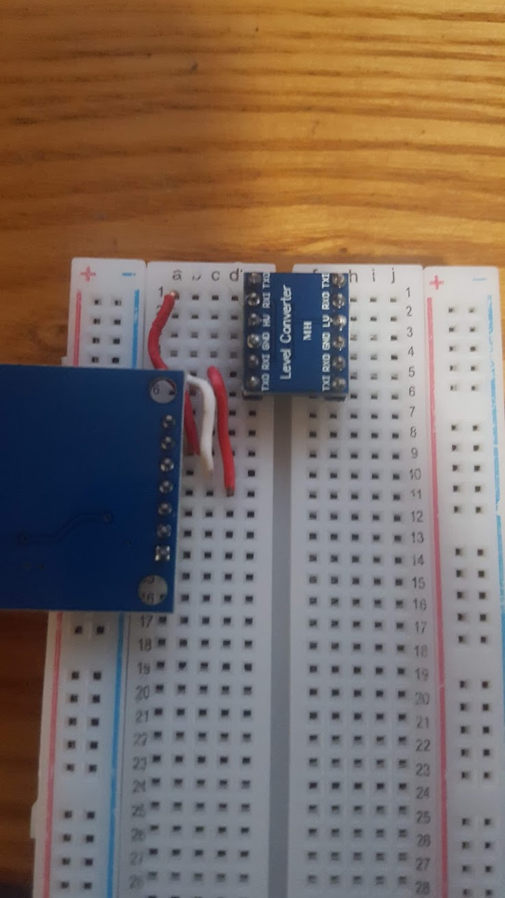
STEP 3!
Add Jumpers from SPI to Level Converter
INT
SCK
SI
SO
CS
GND
VCC
Free PowerPoint Templates
Free PowerPoint Templates
Notes:
Start adding jumpers to attach the SPI lines to the Level Converter
Skip INT (first pin on daughter board)
SCK goes to the top TXI (b,9) to (a,1)
SI goes to the bottom TXI (C,10) to (b,6)
SO goes to the bottom RXI (d,11) to (c,5)
CS goes directly to the Raspberry Pi (We’ll plug this in later!)

Slide 29
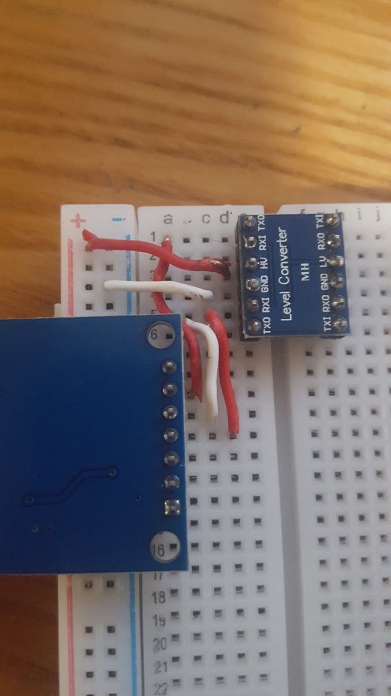
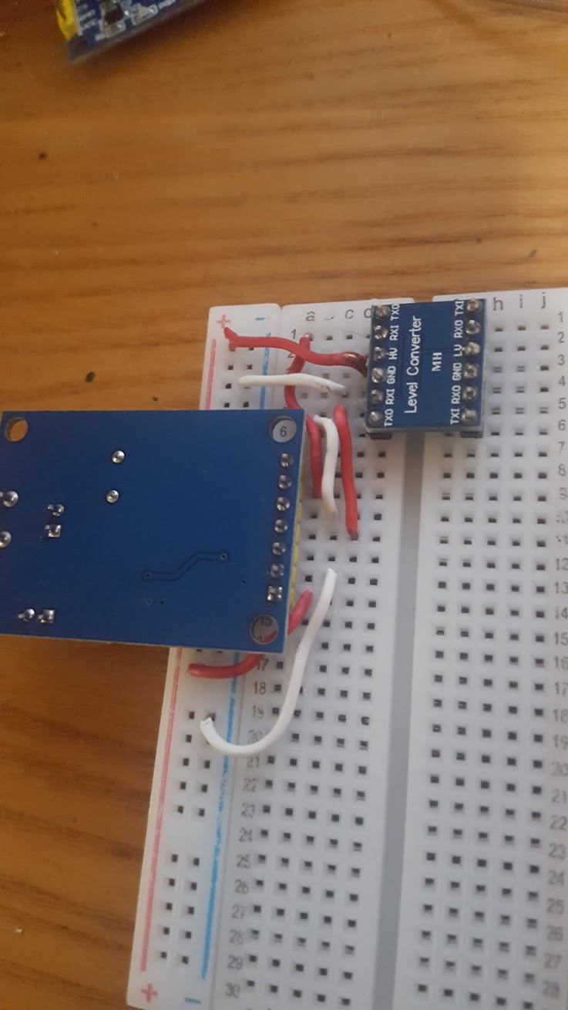
STEP 4!
Add Jumpers from HV power rails to Level Converter and CAN board
INT
SCK
SI
SO
CS
GND
VCC
Free PowerPoint Templates
Free PowerPoint Templates
Notes:
Ground (-) and Pos (+) From the HV (left side)
For Level Converter:
Pos to (d,3)
Neg to (c,4)
For CAN board:
Pos to (b,14)
Neg to (c,13)

Slide 30
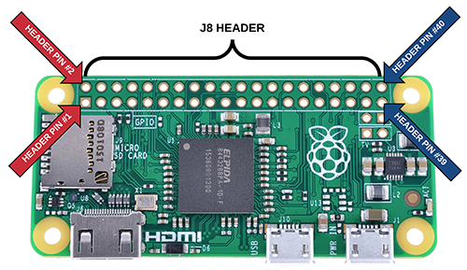
STEP 5!
Check out the Raspberry Pi Zero W!
Free PowerPoint Templates
Free PowerPoint Templates
Notes:
This is the Raspberry Pi Zero W
We’re using Wifi
It’s slower than the normal Raspberry Pi but works OK for CAN
PIN 1 is next to the SD card. We connect by simply counting pins. If you’re ever confused, look for a curved square to indicate Pin 1.

Slide 31
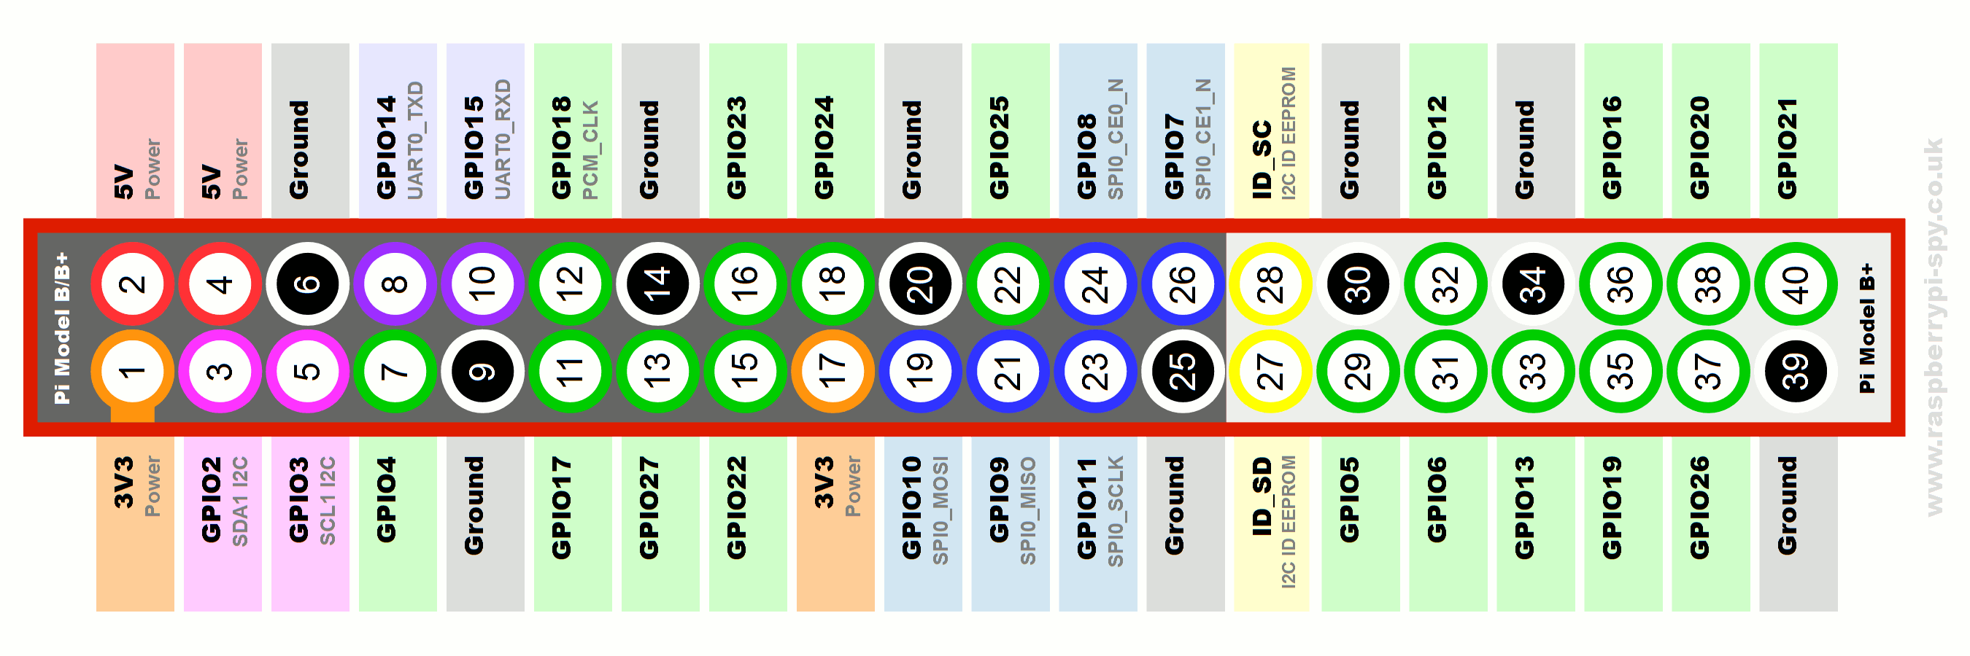
STEP 5.a!
Get familiar with the Raspberry Pi GPIO
We are interested in pins:
1: 3.3-Volt
4. 5-Volt
6. Ground
19. SPI_MOSI
21. SPI_MISO
23. SPI_SCLK
24. SPI_CE0
Free PowerPoint Templates
Free PowerPoint Templates
Notes:
These are the Raspberry GPIO pins. Also in your bags/help docs.
Note although we’re using Pin 4 for 5-Volt, we could use Pin 2.
Althought we’re using Pin 6 for Ground, we could use 9 or 25.
We *MUST* use 19-24 as SPI.

Slide 32
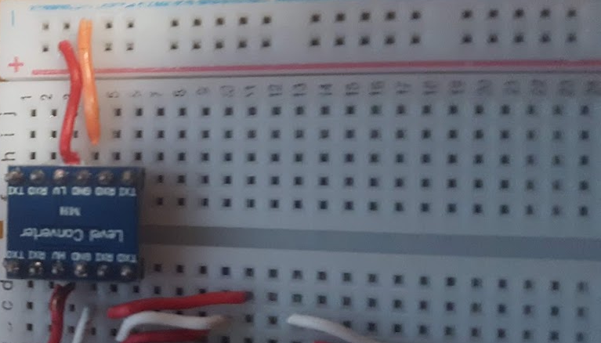
STEP 6!
Start building Low Voltage (LV) Side for Raspberry Pi. Add Jumpers for power and ground
Free PowerPoint Templates
Free PowerPoint Templates
Notes:
Let’s starting building the Low Voltage side to interface with the Raspberry Pi.
First step let’s run power and ground!
LV Power (Positive Rail to (h,3)) or Line 3
LV Ground (Neg rail to (I,4)) or Line 4

Slide 33
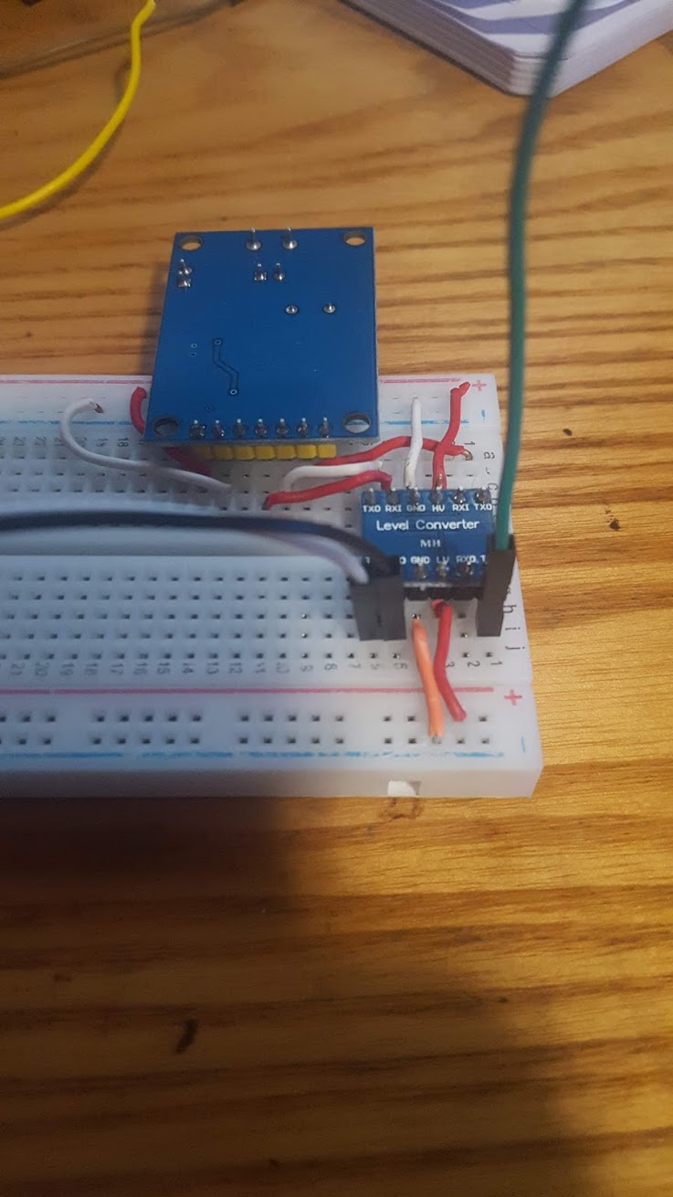
STEP 7!
Now we can add the wires for SPI communication!
Free PowerPoint Templates
Free PowerPoint Templates
Notes:
Add wires to the LV side which match what we added to the CAN Board side
(I,Line-1) for Clock
(I, Line5) for MOSI
(I, Line6) for MISO

Slide 34
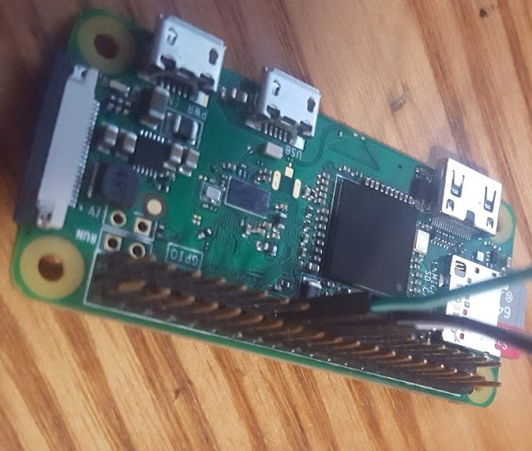
STEP 8!
Connect SPI to the Raspberry Pi
(I,1) SCK to RPI Pin 23
(I,5) MOSI to RPI Pin 19
(I,6) MISO to RPI Pin 21
Free PowerPoint Templates
Free PowerPoint Templates
Notes:
Add wires to the LV side which match what we added to the CAN Board side
(I,1) for Clock to Pin 23
(I,5) for MOSI to Pin 19
(I, 6) for MISO to Pin 21

Slide 35
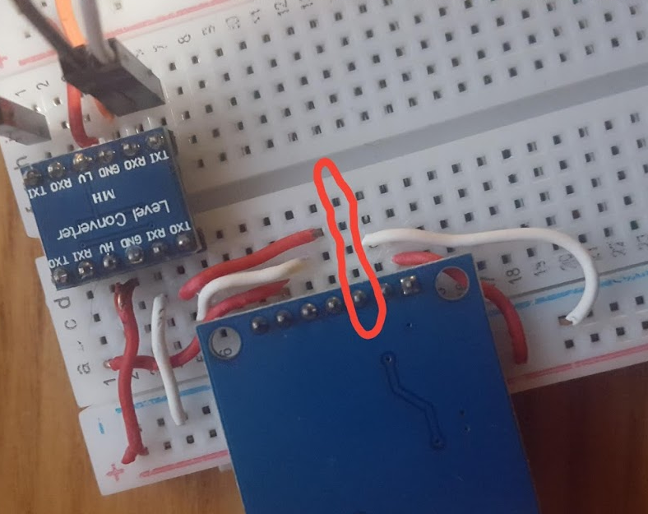
STEP 8.a!
Don’t forget to add the Slave-Select (CS)
(e,12) to RPI Pin 24
INT
SCK
SI
SO
CS
GND
VCC
Free PowerPoint Templates
Free PowerPoint Templates
Notes:
Remember we left one channel open on the CAN board. Let’s not forget to add slave-select, so the raspberry Pi can call on the interface.
(e,12) to raspberry pi pin #24

Slide 36
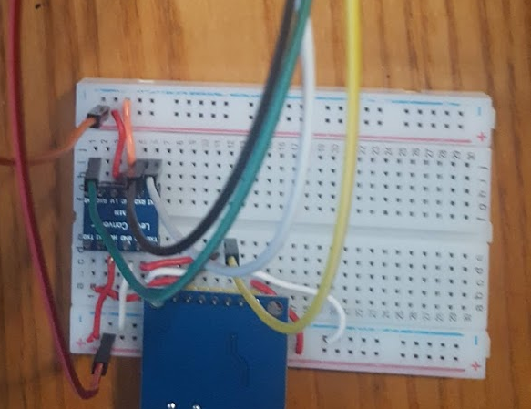
STEP 9!
Start adding power to rails starting with Low-Voltage(LV) Side
INT
SCK
SI
SO
CS
GND
VCC
RPI Pin 1 to LV +
RPI Pin 6 to LV -
RPI Pin 4 to HV +
Free PowerPoint Templates
Free PowerPoint Templates
Notes:
Pay close attention to this part. Pin 1 on the Pi is 3.3v. Pin 2 and 4 are 5v. We will use pin 4 and pin 1 to power our level converter and CAN board.
Place a GPIO wire from pin 1 to the + on the RIGHT (LV) side.

Slide 37
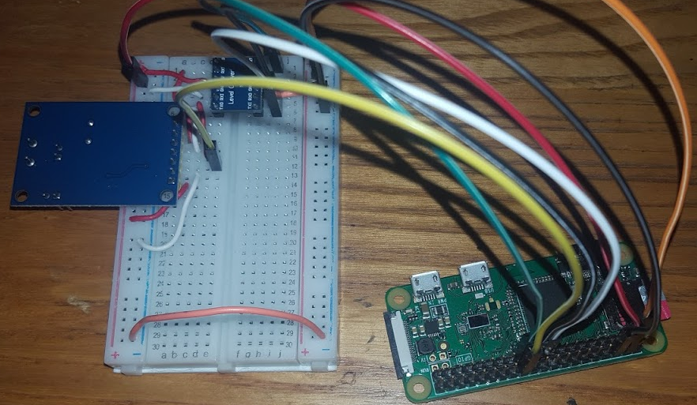
STEP 10!
Add ground to the LV side and bridge it to HV using a jumper. (this helps create a common ground!)
RPI Pin 1 to LV +
RPI Pin 6 to LV -
RPI Pin 4 to HV +
Use a jumper to bridge LV- and HV-
INT
SCK
SI
SO
CS
GND
VCC
Free PowerPoint Templates
Free PowerPoint Templates
Notes:
Pin 6 on the Pi is Ground. Run a GPIO cable from this to the LV side negative post. Then – use a jumper to connect the LV ground to the HV ground.

Slide 38
Free PowerPoint Templates
Free PowerPoint Templates
Notes:
DOUBLE CHECK ALL WIRING PER THE DOCUMENTS!
#####BATHROOM BREAK???######

Slide 39
STEP 11!
Now let’s connect to the Codemash-cars SSID
SSID: Codemash-cars
Password: carsRfun
Free PowerPoint Templates
Free PowerPoint Templates
Notes:
Connect your laptop to the wifi network. The pis should be connected with the Ips assigned.

Slide 40
STEP 11a!
Now let’s plug in peripherals and power on the Raspberry Pis! Then let’s try to ssh:
ssh pi@<IP-On-Bag>
Password: raspberry
Free PowerPoint Templates
Free PowerPoint Templates
Notes:
Now SSH into the Raspberry Pi.

Slide 41
Step 12: Edit the boot config to enable SPI communication
Use your favorite text editor to edit /boot/config.txt
$ | sudo nano /boot/config.txt # add: #
 | dtparam=spi=on
 | dtoverlay=mcp2515-can0,oscillator=8000000,spimaxfrequency=500000
Then
Reboot!
Free PowerPoint Templates
Free PowerPoint Templates
Notes:
Raspberry Pi uses a config.txt file instead of a BIOS.
We need to open it and enable SPI, then assign our CAN interface to it.
Oscillator=8000000 (where CAN gets sampled. This should match the silver clock on the CAN Daughter Board)
Spimaxfrequency=500000 (This is the SPI clock. This is too high by default on the Raspberry Pi to communicate with our CAN devices)

Slide 42
Step 13: Bring the CAN interface up inside of Raspberry Pi
SSH into the Raspberry Pi!
ssh pi@<IP-On-Bag>
password: raspberry
$ | sudo ip link set can0 type can bitrate 500000
$ | sudo ip link set up can0
Now the CAN interface should be up! We will try to connect to our neighbors next.
Free PowerPoint Templates
Free PowerPoint Templates
Notes:
After rebooting, turn on the CAN interface using socketCAN. I installed this before bringing the pis.
If no errors, the MCP2515 is talking and we’ve made it over a huge milestone.

Slide 43
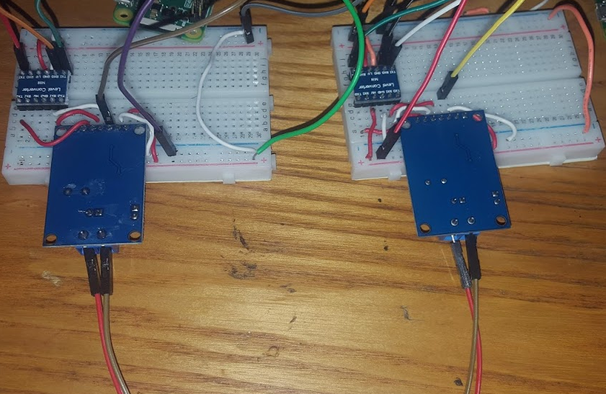
STEP 14!
Look to your left and right. Choose someone to connect to!
Free PowerPoint Templates
Free PowerPoint Templates
Notes:
Before we attach the OBD cable, let’s make sure that we can send and receive CAN messages.
Connect to your neighbor and we will start using a set of tools called ‘can-utils’

Slide 44
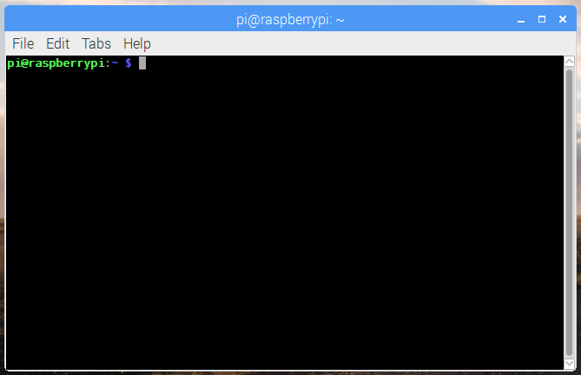
CAN-Utils at a glance
cansend: Send a single message to the CAN network
candump: Print and save traffic generated from your car.
canplayer: Replay traffic that’s been saved with cansniffer: Display raw CAN traffic organized by messages that are constantly changing. cangen: Generate random (very fake/synthetic data)
Free PowerPoint Templates
Notes:
We will use CAN-utils to interface at a low-level with a vehicle. This is based on a package called ‘socketCAN’ which originally was released by Volkswagen.
Can-utils has a handful of built-in functions which are useful in my daily work.
Cansend: Sends CAN messages one at a time
Candump: Dumps raw CAN data in a .log file with the ability to save it for later.
Canplayer: Replays traffic that has been saved with candump.
Cansniffer: Displays CAN traffic in an easy-to-digest way. Focusing on changing messages.
Cangen: Generates very synthetic/fake data, but good for testing connections.

Slide 45
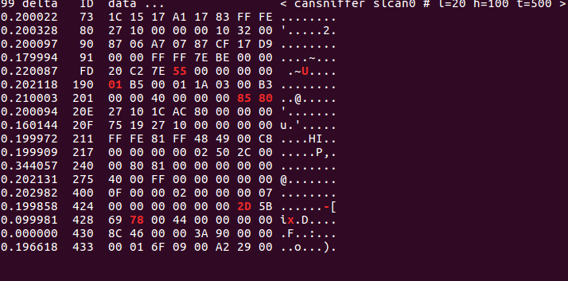
Try to use cansend, candump, cangen, and cansniffer with your friend.
Sam’s Raspberry Pi
1 | cansend can0 123#C0FFEE
2 | cansend can0 123#DEADBEEF
3 | cansend can0 0D7#1122334455667788
Rob’s Raspberry Pi
1 | pi@raspberrypi: ~$ candump can0
2 | can0 127 [3] C0 FF EE
3 | can0 127 [4] DE AD BE EF
4 | can0 0D7 [8] 11 22 33 44 55 66 77 88
Output of cansniffer above
Free PowerPoint Templates
Free PowerPoint Templates
Notes:
With your partner, let’s try to send and receive messages before we commit to connecting to a car. Try out some candump functions, and cansend.

Slide 46
Python-CAN at a glance
Ability to programmatically interact with the CAN
Can send, receive, and logically interact with messages based on content and timing.
Prebuilt Functions: can.viewer – Terminal output for CAN messages. can.player – Replays data saved from python-can can.logger – Can save data which travels over the CAN
Free PowerPoint Templates
Notes:
Python-CAN is a higher-level interface for the CAN Bus. It allows us to interact with CAN via (surprisingly) Python!
Here we can do cool things, such as identify messages and do logical actions based on it.
It also has built-in functions, but can-utils typically performs better under stress. Python-CAN has enabled us to do cool things—such as plot diagnostic messages.

Slide 47
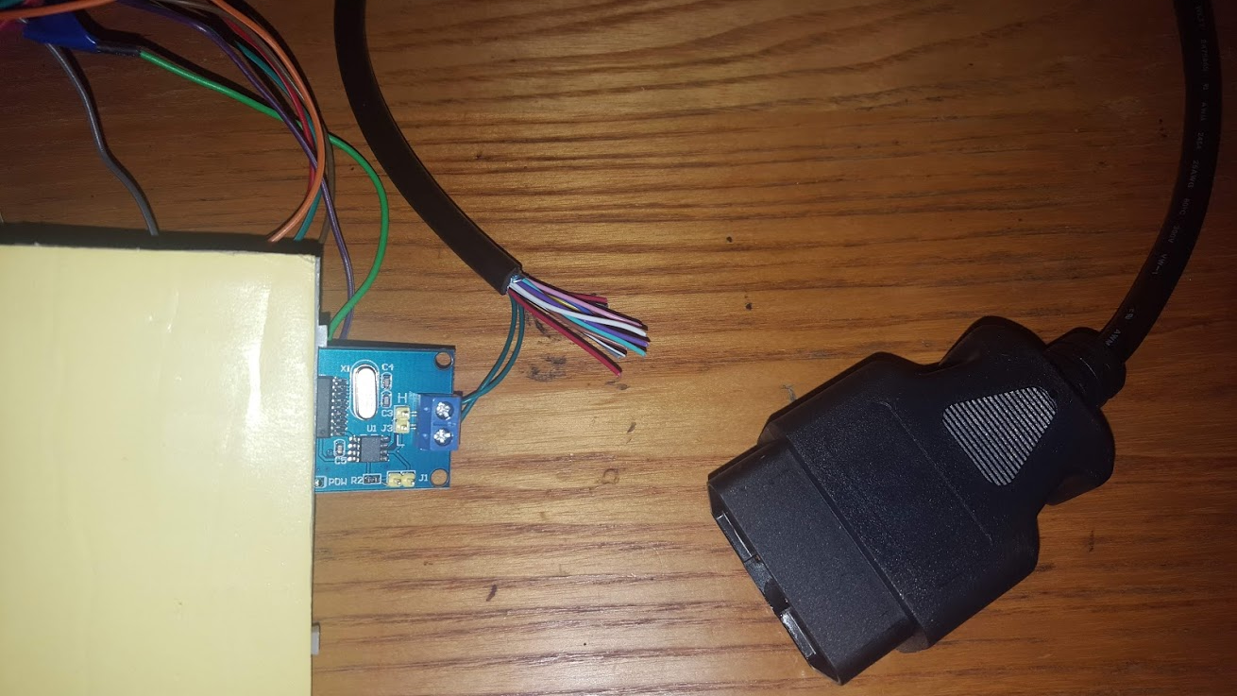

STEP 15! If everything works, let’s add the OBD connector
Free PowerPoint Templates
Free PowerPoint Templates

Slide 48
Try to use send_can_message.py and read_can_message.py with your friend!
Sam’s Raspberry Pi
1 | pi@raspberrypi: ~$ cd /home/pi/python-can
2 | pi@raspberrypi: ~$ python send_can_message.py
Rob’s Raspberry Pi
1 | pi@raspberrypi: ~$ cd /home/pi/python-can
2 | pi@raspberrypi: ~$ python read_can_message.py
Open the scripts with your favorite text editor to experiment. Docs exist at https://python-can.readthedocs.io/en/3.0.0
Free PowerPoint Templates
Free PowerPoint Templates
Notes:
There are a ton of tools you can use to interface with a CAN network. Most of these will require something like J1939-to-DB9 or Serial connector. The Kvaser is completed integrated, you can also use a raspberry pi, Arduino, or more expensive tools like VehicleSpy or CANalyzer

Slide 49
Automotive Networks against OSI:
Application | Automotive Applications (UDS)
Presentation
Session | Higher Layer Protocols (J1939)
Transport
Network | CAN Controller
Data-Link
Physical | CAN Transceiver
https://en.wikipedia.org/wiki/Unified_Diagnostic_Services
Free PowerPoint Templates
Free PowerPoint Templates
Notes:
Now that we’ve worked through CAN a bit, let’s talk about diagnostics and interacting directly with ECUs.

Slide 50
BE SAFE AND CAUTIOUS
1 | Don’t inject data while driving. The vehicle can behave unexpectedly.
2 | You probably will NOT brick your car, but you may void warranties.
3 | Some manufacturers will not like if you attempt to reverse-engineer hardware or software.
4 | At the end of the day, it’s best to tinker at home in your garage!
Free PowerPoint Templates
Free PowerPoint Templates

Slide 51
Talking Cars
(and trucks)
Samuel C. Hollifield
January 2019
Free PowerPoint Templates
Free PowerPoint Templates

